Slide 1
ITC 504 SOFTWARE ENGINEERING

Slide 2
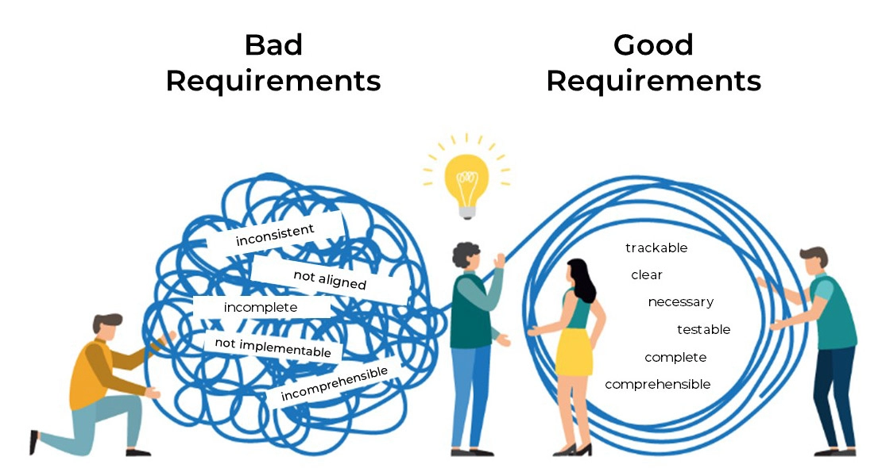
Software requirement

Slide 3
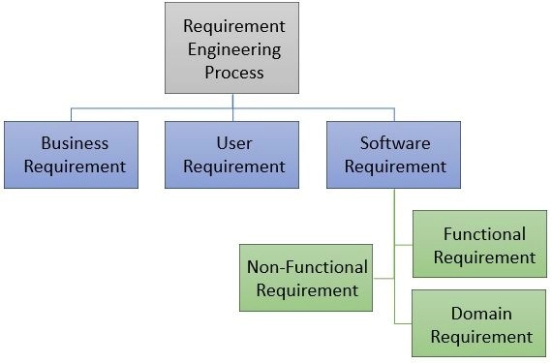
Software requirement

Slide 4
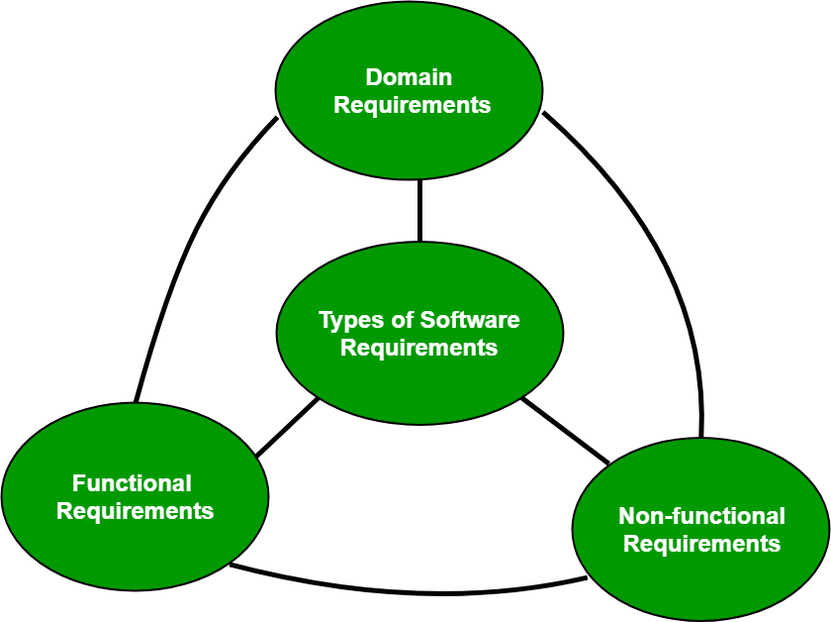
Software requirement
A software requirement can be of 3 types:
Functional requirements
Non-functional requirements
Domain requirements

Slide 5
Software requirement
Functional Requirements:
In software engineering, a functional requirement defines a system or its component. It describes the functions a software must perform. A function is nothing but inputs, its behavior, and outputs. It can be a calculation, data manipulation, business process, user interaction, or any other specific functionality which defines what function a system is likely to perform.
Functional requirements in software engineering help you to capture the intended behavior of the system. This behavior may be expressed as functions, services or tasks or which system is required to perform.

Slide 6
Software requirement
Functional Requirements:
Examples of functional requirements
1. Whenever a user logs into the system, their authentication is done.
2. In case of a cyber attack, the whole system is shut down
3. Whenever a user registers on some software system the first time, a verification email is sent to the user.

Slide 7
Software requirement
Non-Functional Requirement
A non-functional requirement defines the quality attribute of a software system. They represent a set of standards used to judge the specific operation of a system. Example, how fast does the website load? A non-functional requirement is essential to ensure the usability and effectiveness of the entire software system. Failing to meet non-functional requirements can result in systems that fail to satisfy user needs.
Non-functional Requirements allows you to impose constraints or restrictions on the design of the system across the various agile backlogs. Example, the site should load in 3 seconds when the number of simultaneous users are > 10000.

Slide 8
Software requirement
They are also called non-behavioral requirements or quality requirements/attributes.
Non-functional requirements are more abstract. They deal with issues like-
Performance
Reusability
Flexibility
Reliability
Maintainability
Security
Portability

Slide 9
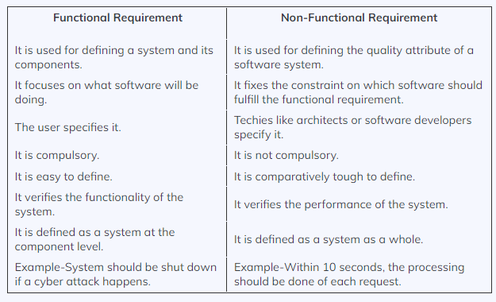
Software requirement

Slide 10
Requirements engineering
1. What are Requirements? Requirements are the descriptions of what the software system should do or the qualities it must possess to address the needs of its users and stakeholders. They can be categorized into two main types:
Functional Requirements: These define the specific functionalities and features the software should provide. They describe what the system should do in response to various inputs and under different conditions.
Non-Functional Requirements: These specify the quality attributes or constraints of the system, such as performance, security, usability, reliability, maintainability, and scalability.

Slide 11
Requirements engineering
2. The Importance of Requirement Engineering: Requirement engineering is vital because it:
Helps understand the problem domain and the goals of the software project.
Assists in identifying potential risks and challenges early in the development process.
Provides a clear and shared understanding among stakeholders about what the software will achieve.
Serves as a basis for estimating project timelines, resources, and costs.
Enables traceability throughout the software development life cycle.

Slide 12
Requirements engineering
3.Requirement Engineering Process:
The broad spectrum of tasks and techniques that lead to an understanding of requirements is called requirements engineering.
Requirements engineering provides the appropriate mechanism for understanding what the customer wants, analyzing need, assessing feasibility, negotiating a reasonable solution, specifying the solution unambiguously, validating the specification, and managing the requirements as they are transformed into an operational system

Slide 13
Requirements engineering
It encompasses seven distinct tasks: inception, elicitation, elaboration, negotiation, specification, validation, and management. It is important to note that some of these tasks occur in parallel and all are adapted to the needs of the project.

Slide 14
Inception
A. Inception
At project inception, you establish a basic understanding of the problem, the people who want a solution, the nature of the solution that is desired, and the effectiveness of preliminary communication and collaboration between the other stakeholders and the software team

Slide 15
Elicitation
B Elicitation:
This is also known as the gathering of requirements. Here, requirements are identified with the help of customers and existing systems processes, if available.
Analysis of requirements starts with requirement elicitation. The requirements are analyzed to identify inconsistencies, defects, omission, etc. We describe requirements in terms of relationships and also resolve conflicts if any.

Slide 16
Elicitation
Requirements Elicitation is the process to find out the requirements for an intended software system by communicating with client, end users, system users and others who have a stake in the software system development.
There are various ways to discover requirements

Slide 17
Elicitation
i. Interviews
Interviews are strong medium to collect requirements. Organization may conduct several types of interviews such as:
Structured (closed) interviews, where every single information to gather is decided in advance, they follow pattern and matter of discussion firmly.
Non-structured (open) interviews, where information to gather is not decided in advance, more flexible and less biased.

Slide 18
Elicitation
Oral interviews
Written interviews
One-to-one interviews which are held between two persons across the table.
Group interviews which are held between groups of participants. They help to uncover any missing requirement as numerous people are involved.

Slide 19
Elicitation
ii. Surveys
Organization may conduct surveys among various stakeholders by querying about their expectation and requirements from the upcoming system.

Slide 20
Elicitation
iii. Questionnaires
A document with pre-defined set of objective questions and respective options is handed over to all stakeholders to answer, which are collected and compiled.
A shortcoming of this technique is, if an option for some issue is not mentioned in the questionnaire, the issue might be left unattended.

Slide 21
Elicitation
iv.Task analysis
Team of engineers and developers may analyze the operation for which the new system is required. If the client already has some software to perform certain operation, it is studied and requirements of proposed system are collected.
Domain Analysis
Every software falls into some domain category. The expert people in the domain can be a great help to analyze general and specific requirements.

Slide 22
Elicitation
v.Brainstorming
An informal debate is held among various stakeholders and all their inputs are recorded for further requirements analysis.

Slide 23
Elicitation
vi. Observation
Team of experts visit the client’s organization or workplace. They observe the actual working of the existing installed systems. They observe the workflow at client’s end and how execution problems are dealt. The team itself draws some conclusions which aid to form requirements expected from the software.

Slide 24
Elicitation
Problems of Elicitation and Analysis:
Getting all, and only, the right people involved.
Stakeholders often don't know what they want
Stakeholders express requirements in their terms.
Stakeholders may have conflicting requirements.
Requirement change during the analysis process.
Organizational and political factors may influence system requirements.

Slide 25
C. Feasibility study
When the client approaches the organization for getting the desired product developed, it comes up with rough idea about what all functions the software must perform and which all features are expected from the software.
Referencing to this information, the analysts does a detailed study about whether the desired system and its functionality are feasible to develop.

Slide 26
Elaboration
D. Elaboration
The information obtained from the customer during inception and elicitation is expanded and refined during elaboration. This task focuses on developing a refined requirements model that identifies various aspects of software function, behavior, and information.

Slide 27
Negotiation
E. Negotiation
It isn’t unusual for customers and users to ask for more than can be
achieved, given limited business resources. It’s also relatively common for different customers or users to propose conflicting requirements, arguing that their version is “essential for our special needs.” You have to reconcile these conflicts through a process of negotiation.

Slide 28
Specification
F. Specification
Documenting the requirements in a clear and unambiguous manner. A specification can be a written document, a set of graphical models, a formal mathematical model, a collection of usage scenarios, a prototype, or any combination of these.

Slide 29
Software Requirements Specification (SRS)
software requirements specification (SRS):
A software requirements specification (SRS) is a document that describes what the software will do and how it will be expected to perform. It also describes the functionality the product needs to fulfill all stakeholders (business, users) needs.

Slide 30
Software Requirements Specification (SRS)
An SRS minimizes the time and effort required by developers to achieve desired goals and also minimizes the development cost. A good SRS defines how an application will interact with system hardware, other programs and human users in a wide variety of real-world situations. Parameters such as operating speed, response time, availability, portability, maintainability, footprint, security and speed of recovery from adverse events are evaluated. Methods of defining an SRS are described by the IEEE (Institute of Electrical and Electronics Engineers) specification 830-1998.

Slide 31
Quality Characteristics of a good SRS
Correctness:
User review is used to ensure the correctness of requirements stated in the SRS. SRS is said to be correct if it covers all the requirements that are actually expected from the system.
Completeness:
Completeness of SRS indicates every sense of completion including the numbering of all the pages, resolving the to be determined parts to as much extent as possible as well as covering all the functional and non-functional requirements properly.

Slide 32
Quality Characteristics of a good SRS
Consistency:
Requirements in SRS are said to be consistent if there are no conflicts between any set of requirements. Examples of conflict include differences in terminologies used at separate places, logical conflicts like time period of report generation, etc.
Unambiguousness:
A SRS is said to be unambiguous if all the requirements stated have only 1 interpretation. Some of the ways to prevent unambiguousness include the use of modelling techniques like ER diagrams, proper reviews and buddy checks, etc.

Slide 33
Quality Characteristics of a good SRS
Ranking for importance and stability:
There should a criterion to classify the requirements as less or more important or more specifically as desirable or essential. An identifier mark can be used with every requirement to indicate its rank or stability.
Modifiability:
SRS should be made as modifiable as possible and should be capable of easily accepting changes to the system to some extent. Modifications should be properly indexed and cross-referenced.

Slide 34
Quality Characteristics of a good SRS
Verifiability:
A SRS is verifiable if there exists a specific technique to quantifiably measure the extent to which every requirement is met by the system. For example, a requirement starting that the system must be user-friendly is not verifiable and listing such requirements should be avoided.
Traceability:
One should be able to trace a requirement to design component and then to code segment in the program. Similarly, one should be able to trace a requirement to the corresponding test cases.

Slide 35
Quality Characteristics of a good SRS
Design Independence:
There should be an option to choose from multiple design alternatives for the final system. More specifically, the SRS should not include any implementation details.
Testability:
A SRS should be written in such a way that it is easy to generate test cases and test plans from the document.

Slide 36
Quality Characteristics of a good SRS
Understandable by the customer:
An end user maybe an expert in his/her specific domain but might not be an expert in computer science. Hence, the use of formal notations and symbols should be avoided to as much extent as possible. The language should be kept easy and clear.
Right level of abstraction:
If the SRS is written for the requirements phase, the details should be explained explicitly. Whereas, for a feasibility study, fewer details can be used. Hence, the level of abstraction varies according to the purpose of the SRS.

Slide 37
G.Validation: Reviewing the documented requirements to ensure they accurately reflect the stakeholders' needs. It helps to identify
• Is each requirement consistent with the overall objectives for the system/product?
• Have all requirements been specified at the proper level of abstraction? That is, do some requirements provide a level of technical detail that is inappropriate at this stage?
• Is the requirement really necessary or does it represent an add-on feature that may not be essential to the objective of the system?

Slide 38
Validation Checklist
• Is each requirement bounded and unambiguous?
• Does each requirement have attribution? That is, is a source (generally, a specific individual) noted for each requirement?
• Do any requirements conflict with other requirements?
• Is each requirement achievable in the technical environment that will house the system or product?
• Is each requirement testable, once implemented?
• Does the requirements model properly reflect the information, function, and behavior of the system to be built?

Slide 39
Validation Checklist
• Has the requirements model been “partitioned” in a way that exposes progressively more detailed information about the system?
• Have requirements patterns been used to simplify the requirements model? Have all patterns been properly validated? Are all patterns consistent with customer requirements?

Slide 40
H.Management: Tracking and controlling changes to requirements throughout the development process. Managing requirements involves versioning, configuration management, and maintaining a traceability matrix to link requirements with design, implementation, and testing artifacts.

Slide 41
4. Challenges in Requirement Engineering: Requirement engineering is a complex and challenging task due to several factors:
Incomplete Information: Stakeholders might not be fully aware of their needs or might not articulate them clearly.
Changing Requirements: Requirements can evolve over time due to changing business needs or external factors.
Conflicting Requirements: Different stakeholders may have conflicting interests or priorities.
Ambiguity: Requirements may be stated vaguely or imprecisely, leading to misinterpretations.

Slide 42
5. Requirement Documentation: Various documentation techniques are used to capture and represent requirements. Some common artifacts include:
User Stories: Short descriptions of a specific user's needs, often written in the form of "As a [type of user], I want [an action] so that [benefit]."
Use Cases: Descriptions of interactions between actors (users or systems) and the system, showing the flow of events and expected behavior.
Requirement Specifications: Detailed statements of functional and non-functional requirements, often written in a structured format.

Slide 43
Use case
We'll create a use case story for the "Add to Cart" functionality. This use case will describe the interaction between the user and the system when adding items to their shopping cart.
Use Case Story: Add to Cart
Title: Add to Cart
Primary Actor: Online Shopper
Preconditions:
The online shopper is logged in to their account.
The online shopper is browsing the online store and viewing a product they want to purchase.

Slide 44
Use case
Main Success Scenario:
The online shopper selects a product they want to buy and clicks on the "Add to Cart" button.
The system verifies that the selected product is in stock and available for purchase.
The system displays a confirmation message indicating that the product has been added to the cart.
The online shopper can choose to continue shopping or proceed to the checkout process.

Slide 45
Use case
Alternative Scenarios:
A. Product Out of Stock:
In Step 2 of the Main Success Scenario, if the selected product is not in stock or unavailable, the system displays an error message stating that the product is out of stock.
The online shopper can choose to select a different product or continue shopping.

Slide 46
Use case
B. Multiple Quantity Selection:
In Step 1 of the Main Success Scenario, the online shopper can specify the desired quantity of the product before clicking the "Add to Cart" button.
The system verifies that the selected quantity is available in stock.
If the quantity is available, the system adds the specified quantity of the product to the cart and displays a confirmation message.
If the quantity is not available, the system displays an error message indicating the available stock quantity.

Slide 47
Use case
Postconditions:
The selected product is added to the online shopper's shopping cart.
The online shopper can see the updated cart with the added product.
Extensions:
C. Continue to Checkout:
After adding products to the cart, the online shopper can choose to proceed to the checkout process by clicking on the "Checkout" button.
The system navigates the online shopper to the checkout page to complete the purchase.

Slide 48
Use case
D. Continue Shopping:
After adding products to the cart, the online shopper can choose to continue shopping by browsing other products on the online store.
This use case story provides a clear and concise description of how the "Add to Cart" functionality should work in the online shopping system. It outlines the main steps, alternative scenarios, and postconditions, helping stakeholders understand the requirements for this particular feature. Use case stories like this help ensure that all stakeholders have a shared understanding of the system's behavior and facilitate effective communication between developers, testers, and users.

Slide 49
6. Verification and Validation: Verification involves checking that the requirements are well-written, complete, consistent, and conform to the standards. Validation, on the other hand, ensures that the requirements accurately represent the stakeholders' needs.
7. Requirements Change Management: Requirements can change throughout the project, so it's essential to have a change management process in place to handle modifications, assess their impact, and update relevant documents and artifacts.

Slide 50
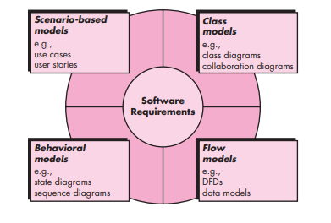
Requirements Modeling

Slide 51
Requirements Modeling
SCENARIO-BASED MODELING:
Scenario-based modeling is a requirement modeling technique that focuses on capturing and describing specific instances or sequences of events that illustrate how the system will behave in various situations. It involves creating scenarios, which are detailed descriptions of interactions between actors (users or external systems) and the system to achieve specific goals or use cases. Scenario-based modeling is particularly useful for understanding and validating system behavior and for identifying potential issues and edge cases.

Slide 52
Requirements Modeling
Use Case Diagram
A use case diagram in software engineering that represents the interactions between actors (users or external systems) and the system itself. It provides a high-level view of the functional requirements of a system and helps visualize how users interact with the system to achieve specific goals or use cases.

Slide 53
Requirements Modeling
Here's a breakdown of the main components and concepts in a use case diagram:
Actors:
Actors represent the different roles that interact with the system. An actor can be a user (e.g., customer, administrator) or an external system (e.g., payment gateway, email service).
Each actor is depicted as a stick figure icon on the diagram.
Use Cases:
Use cases represent the specific functionalities or interactions that the system provides to its actors.
Each use case is depicted as an oval on the diagram and is named to describe the action or task it represents.

Slide 54
Requirements Modeling
Associations:
Associations (also known as lines or connectors) show the relationship between actors and use cases.
An association line connects an actor to the use case they are involved with or to the use case they initiate or interact with.
System Boundary:
The system boundary is a box that encloses all the use cases of the system and separates the system from its external actors.
It helps define the scope of the system and what lies within it.

Slide 55
Requirements Modeling
Include and Extend Relationships:
Include relationships represent a relationship between two use cases, where one use case (the base use case) includes the functionality of another use case (the included use case).
Extend relationships represent optional or exceptional behavior that can be added to a base use case.
These relationships are depicted with arrows and labeled with "«include»" and "«extend»" respectively.

Slide 56
Requirements Modeling
Generalization:
Generalization (inheritance) relationships show how a child use case inherits the behavior of a parent use case.
The generalization relationship is depicted as an arrow from the child use case to the parent use case and is labeled with the keyword "«extends»".

Slide 57
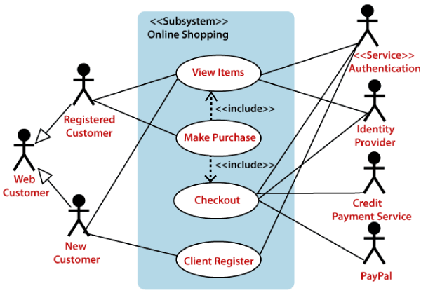
Requirements Modeling

Slide 58
Requirements Modeling
There are many requirements modeling situations in which a text-based model— even one as simple as a use case—may not impart information in a clear and concise manner. In such cases, you can choose from a broad array of UML graphical models.
1. Activity Diagram: An activity diagram models the flow of activities or actions within a system or a specific process. It is a visual representation of the sequential and concurrent behavior of the system, showing how activities are performed, decisions are made, and control flows from one activity to another. Activity diagrams are useful for understanding the dynamic behavior of a system, including business processes, use cases, workflows, and algorithms.
Key components and concepts of activity diagrams include:

Slide 59
Requirements Modeling
Activity:
An activity represents a specific action or task that occurs within the system. It can be a simple action, like "Calculate Total Price," or a complex series of actions.
Activities are depicted as rounded rectangles with the activity name inside.
Control Flow:
Control flow arrows show the flow of control from one activity to another. They represent the sequence in which activities are performed.
Control flow arrows have arrowheads and are usually labeled with conditions or constraints that determine the path the control flow will follow.

Slide 60
Requirements Modeling
Decision Nodes (Decision Diamonds):
Decision nodes represent points in the activity diagram where the flow of control splits into multiple alternative paths based on certain conditions or decisions.
The decision node is represented by a diamond shape, and each outgoing arrow represents a possible decision outcome.
Merge Nodes (Merge Diamonds):
Merge nodes represent points where multiple control flow paths converge back into a single path after a decision or parallel execution.
Merge nodes are also depicted as diamond shapes.

Slide 61
Requirements Modeling
Forks and Joins:
Fork nodes are used to split the control flow into multiple concurrent paths, allowing activities to be performed in parallel.
Join nodes are used to synchronize the concurrent control flow paths back into a single path.
Start and End Nodes:
The start node marks the beginning of the activity diagram, indicating where the process or activity starts.
The end node marks the completion of the activity diagram, indicating where the process or activity ends.

Slide 62
Requirements Modeling
Object Nodes:
Object nodes represent data or objects that are passed between activities. They are often used to show the flow of data between actions.
Activity diagrams are commonly used to model complex workflows, business processes, or system behaviors in software development. They provide a clear and easy-to-understand visualization of how activities are executed and how decisions are made within the system. By using activity diagrams, software engineers and stakeholders can gain insights into the overall flow of the system and identify potential bottlenecks, inefficiencies, or areas for improvement. Additionally, activity diagrams are an essential tool for communication and collaboration between different stakeholders, helping ensure a shared understanding of the system's behavior and functionality.

Slide 63
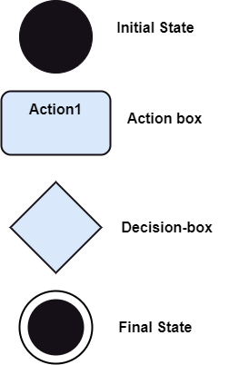
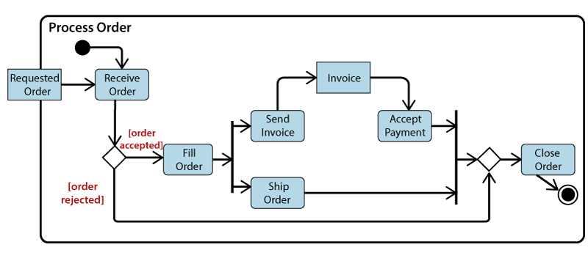
Requirements Modeling

Slide 64
Requirements Modeling
Swimlane Diagrams
The UML swimlane diagram is a useful variation of the activity diagram and allows you to represent the flow of activities described by the use case and at the same time indicate which actor (if there are multiple actors involved in a specific use case) or analysis class has responsibility for the action described by an activity rectangle. Responsibilities are represented as parallel segments that divide the diagram vertically, like the lanes in a swimming pool

Slide 65
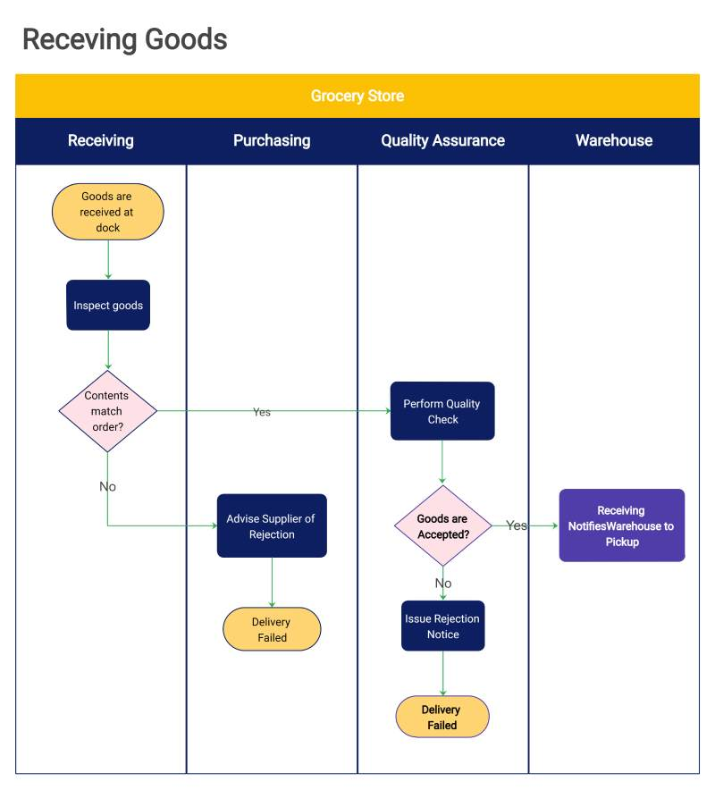
Requirements Modeling

Slide 66
Requirements Modeling
Behavior Modeling:
Behavioral modeling in software engineering is a technique used to model and describe the dynamic behavior of a software system. It focuses on understanding how the system behaves, reacts, and interacts with its environment, users, and other systems during its execution. Behavioral modeling is crucial for capturing the system's functionality, use cases, workflows, and the sequence of actions that occur in response to events. It helps stakeholders and software developers gain insights into the system's dynamic aspects and ensure that it meets the desired requirements.
Some common techniques used for behavioral modeling in software engineering include:

Slide 67
Requirements Modeling
Sequence Diagrams: https://www.visual-paradigm.com/guide/uml-unified-modeling-language/what-is-sequence-diagram/

Slide 68
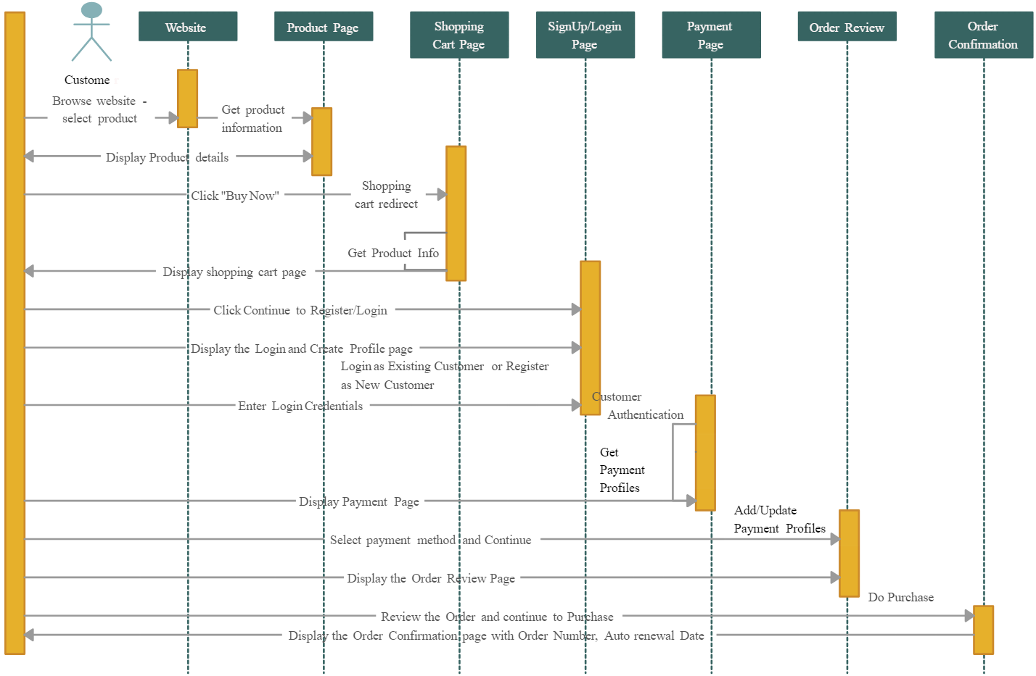
Requirements Modeling

Slide 69
Requirements Modeling
State Transition Diagrams: https://www.visual-paradigm.com/guide/uml-unified-modeling-language/what-is-state-machine-diagram/

Slide 70
Requirements Modeling
CLASS -BASED MODELING:
Class-based modeling represents the objects that the system will manipulate, the operations (also called methods or services) that will be applied to the objects to effect the manipulation, relationships (some hierarchical) between the objects, and the collaborations that occur between the classes that are defined. The elements of a class-based model include classes and objects, attributes, operations, class responsibility-collaborator (CRC) models, collaboration diagrams

Slide 71
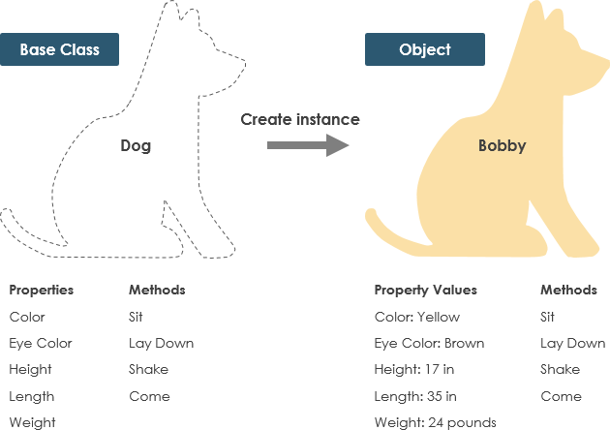
Requirements Modeling

Slide 72
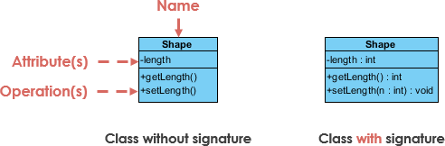
Requirements Modeling
UML Class Notation
A class represent a concept which encapsulates state (attributes) and behavior (operations). Each attribute has a type. Each operation has a signature. The class name is the only mandatory information.

Slide 73
Requirements Modeling
Class Name:
The name of the class appears in the first partition.
Class Attributes:
Attributes are shown in the second partition.
The attribute type is shown after the colon.
Attributes map onto member variables (data members) in code.

Slide 74
Requirements Modeling
Class Name: The name of the class appears in the first partition.
Class Attributes: Attributes are shown in the second partition.
The attribute type is shown after the colon.
Attributes map onto member variables (data members) in code.
Class Operations (Methods):
Operations are shown in the third partition. They are services the class provides.
The return type of a method is shown after the colon at the end of the method signature.
The return type of method parameters are shown after the colon following the parameter name. Operations map onto class methods in code

Slide 75
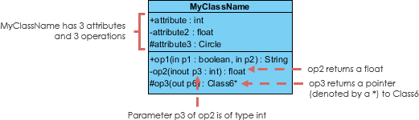
Requirements Modeling

Slide 76
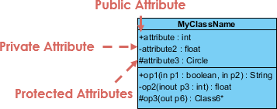
Requirements Modeling
Class Visibility
The +, - and # symbols before an attribute and operation name in a class denote the visibility of the attribute and operation.
+ denotes public attributes or operations
- denotes private attributes or operations
# denotes protected attributes or operations

Slide 77
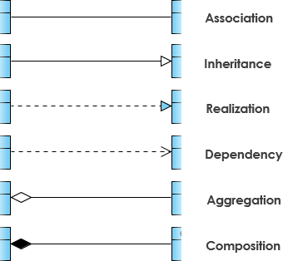
Requirements Modeling
Relationships between classes

Slide 78
Requirements Modeling
Inheritance (or Generalization):
A generalization is a taxonomic relationship between a more general classifier and a more specific classifier. Each instance of the specific classifier is also an indirect instance of the general classifier. Thus, the specific classifier inherits the features of the more general classifier.
Represents an "is-a" relationship.
An abstract class name is shown in italics.
SubClass1 and SubClass2 are specializations of SuperClass.

Slide 79
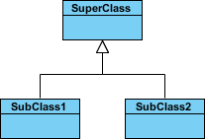
Requirements Modeling
The figure below shows an example of inheritance hierarchy. SubClass1 and SubClass2 are derived from SuperClass. The relationship is displayed as a solid line with a hollow arrowhead that points from the child element to the parent element.

Slide 80
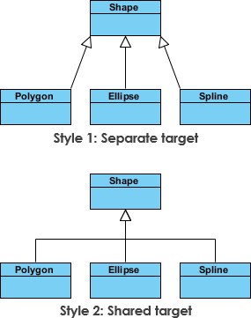
Requirements Modeling
Inheritance Example - Shapes
The figure below shows an inheritance example with two styles. Although the connectors are drawn differently, they are semantically equivalent.

Slide 81

Requirements Modeling
Association: Associations are relationships between classes in a UML Class Diagram. They are represented by a solid line between classes. Associations are typically named using a verb or verb phrase which reflects the real world problem domain.
Simple Association: A structural link between two peer classes.
There is an association between Class1 and Class2
The figure below shows an example of simple association. There is an association that connects the <<control>> class Class1 and <<boundary>> class Class2. The relationship is displayed as a solid line connecting the two classes.

Slide 82
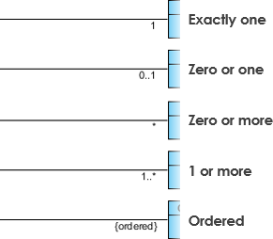
Requirements Modeling
Cardinality
Cardinality is expressed in terms of:
one to one
one to many
many to many

Slide 83

Requirements Modeling
Aggregation: A special type of association.
It represents a "part of" relationship.
Class2 is part of Class1.
Many instances (denoted by the *) of Class2 can be associated with Class1.
Objects of Class1 and Class2 have separate lifetimes.
The figure below shows an example of aggregation. The relationship is displayed as a solid line with a unfilled diamond at the association end, which is connected to the class that represents the aggregate.

Slide 84

Requirements Modeling
Composition
A special type of aggregation where parts are destroyed when the whole is destroyed.
Objects of Class2 live and die with Class1.
Class2 cannot stand by itself.
The figure below shows an example of composition. The relationship is displayed as a solid line with a filled diamond at the association end, which is connected to the class that represents the whole or composite.

Slide 85

Requirements Modeling
Dependency
An object of one class might use an object of another class in the code of a method. If the object is not stored in any field, then this is modeled as a dependency relationship.
A special type of association.
Exists between two classes if changes to the definition of one may cause changes to the other (but not the other way around).
Class1 depends on Class2
The figure below shows an example of dependency. The relationship is displayed as a dashed line with an open arrow.

Slide 86
Requirements Modeling
class Bank:
def __init__(self, name):
self.name = name
self.accounts = []
def create_account(self, account_number, customer):
account = Account(account_number, customer)
self.accounts.append(account)
return account
class Customer:
def __init__(self, id, name):
self.id = id
self.name = name

Slide 87
Requirements Modeling
class Account:
def __init__(self, account_number, customer):
self.account_number = account_number
self.customer = customer
self.balance = 0
self.transactions = []
def deposit(self, amount):
self.balance += amount
self.transactions.append(f"Deposit of {amount}")
def withdraw(self, amount):
if self.balance >= amount:
self.balance -= amount
self.transactions.append(f"Withdrawal of {amount}")
else:
print("Insufficient funds")
def get_balance(self):
return self.balance
def get_transactions(self):
return self.transactions

Slide 88
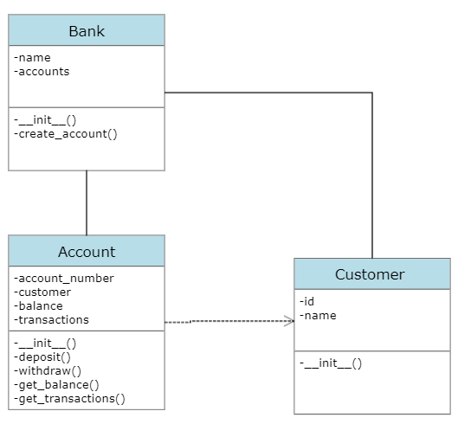
Requirements Modeling
# Creating objects based on the class diagram
bank = Bank("MyBank")
customer = Customer(1, "John Doe")
account = bank.create_account("123456", customer)
account.deposit(1000)
account.withdraw(500)
print(f"Account Balance: {account.get_balance()}")
print(f"Account Transactions: {account.get_transactions()}")
https://youtu.be/qOKK5yAnEc0

Slide 89
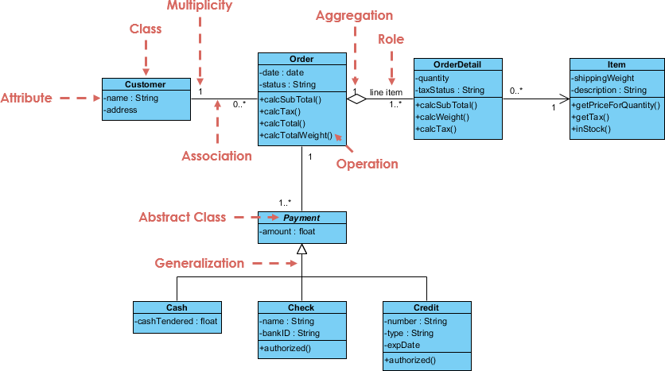
Requirements Modeling

Slide 90
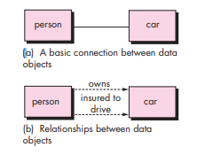
Requirements Modeling
Data Objects
Data Attributes
Relationships

Slide 91
Requirements Modeling
Data Modeling:
If software requirements include the need to create, extend, or interface with a database or if complex data structures must be constructed and manipulated, the software team may choose to create a data model as part of overall requirements modeling. A software engineer or analyst defines all data objects that are processed within the system, the relationships between the data objects, and other information that is pertinent to the relationships. The entity-relationship diagram (ERD) addresses these issues and represents all data objects that are entered, stored, transformed, and produced within an application

